Slide 1

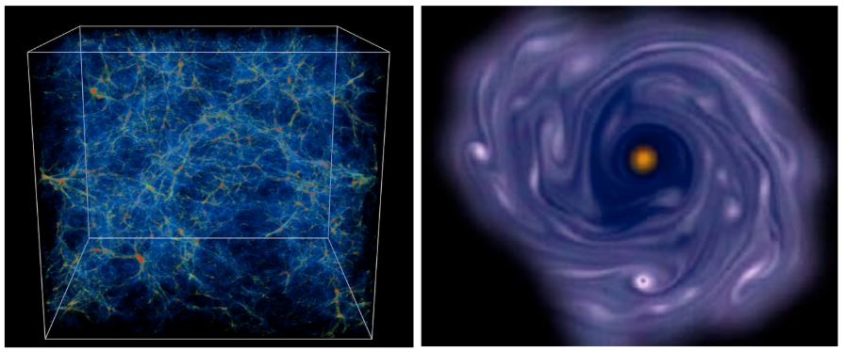
COLUMBIA ASTROPHYSICS LABORATORY
Located in New York City, Columbia University offers a graduate program in astronomy and astrophysics with a primary focus on the development of research skills. The goal of this program is to produce creative and independent scientists who will advance the frontiers of our discipline, educate the next generation of astronomers, and engage the public in our endeavor to understand the Universe.
Our community includes faculty, researchers, and students in Astronomy and Astrophysics at Columbia University, Barnard College, NASA’s Goddard Institute for Space Studies, the American Museum of Natural History and the Simons Center for Computational Astronomy, all of whom are pursuing a wide range of theoretical, computational, observational, and experimental research.

Slide 2
Astronomy Department Office – Room 1328

Slide 3
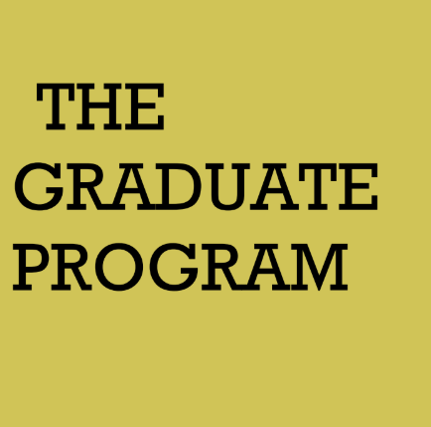
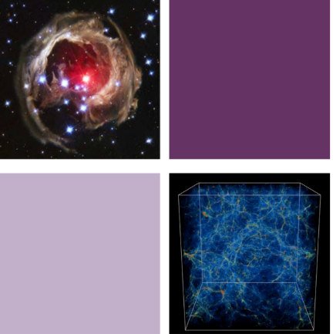
The graduate program for the Ph.D. is designed to foster the intellectual and professional development of our students. To this end, graduate students are fully integrated into all of our Department’s activities.
The primary goal of the program is to cultivate the ability to perform original, independent research. Shortly after arrival on campus, incoming students choose their first faculty-guided research project. In the first two years, each student will work with two different faculty members in two distinct areas of astronomy. Many students submit the results of these research projects for publication in professional journals. Instead of a traditional qualifying exam, research exams are held at the completion of the first and second year. Our course requirements are designed to impart the knowledge necessary for research in astronomy. The culmination of this two years of preparation comes in the form of a dissertation proposal presented before a committee in the third year. The remaining part of the graduate student's career is devoted to completing a seminal piece of original research.
The graduate program for the Ph.D. is designed to foster the intellectual and professional development of our students. To this end, graduate students are fully integrated into all of our Department’s activities. The primary goal of the program is to cultivate the ability to perform original, independent research. Shortly after arrival on campus, incoming students choose their first faculty-guided research project. In the first two years, each student will work with two different faculty members in two distinct areas of astronomy. Many students submit the results of these research projects for publication in professional journals. Instead of a traditional qualifying exam, research exams are held at the completion of the first and second year. Our course requirements are designed to impart the knowledge necessary for research in astronomy. The culmination of this two years of preparation comes in the form of a dissertation proposal presented before a committee in the third year. The remaining part of the graduate student's career is devoted to completing a seminal piece of original research.

Slide 4
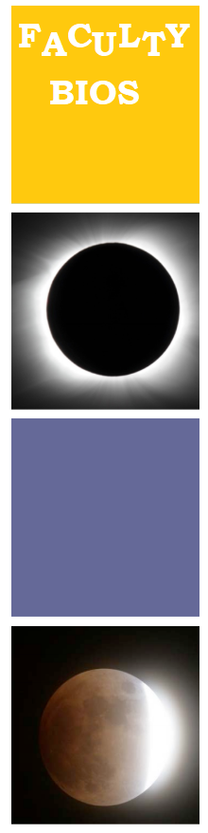
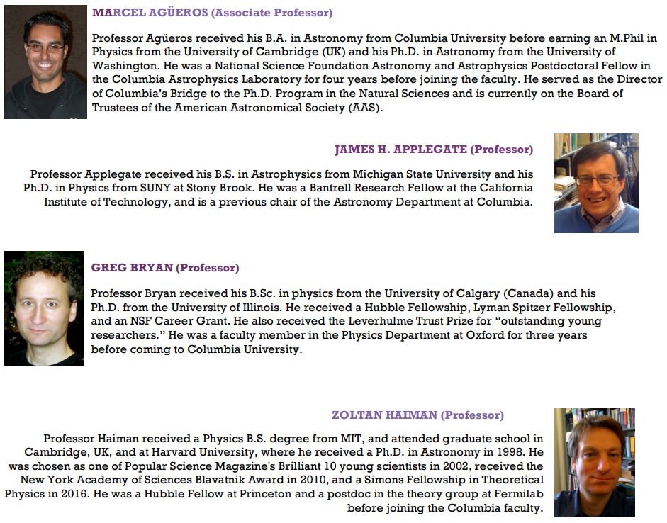

Slide 5
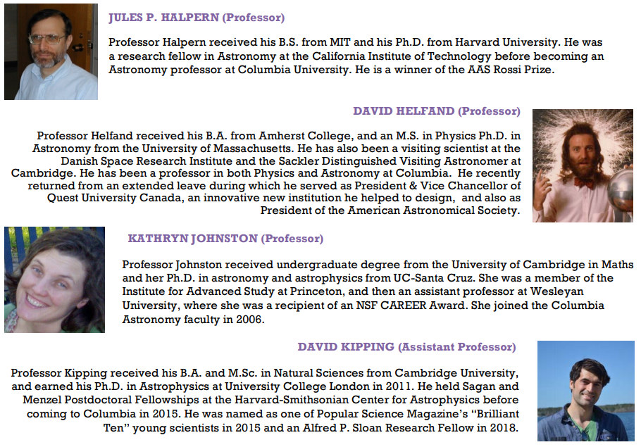

Slide 6
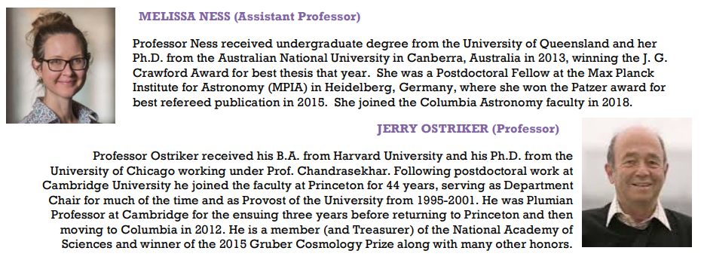
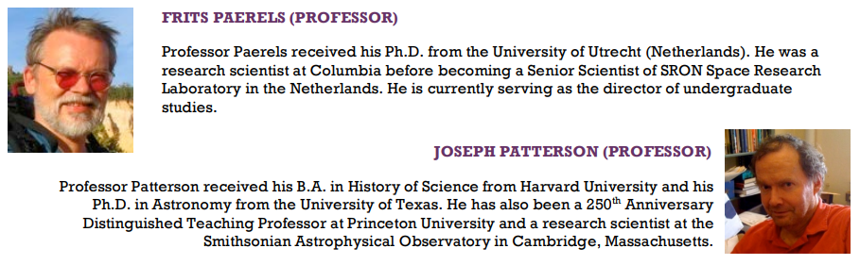

Slide 7
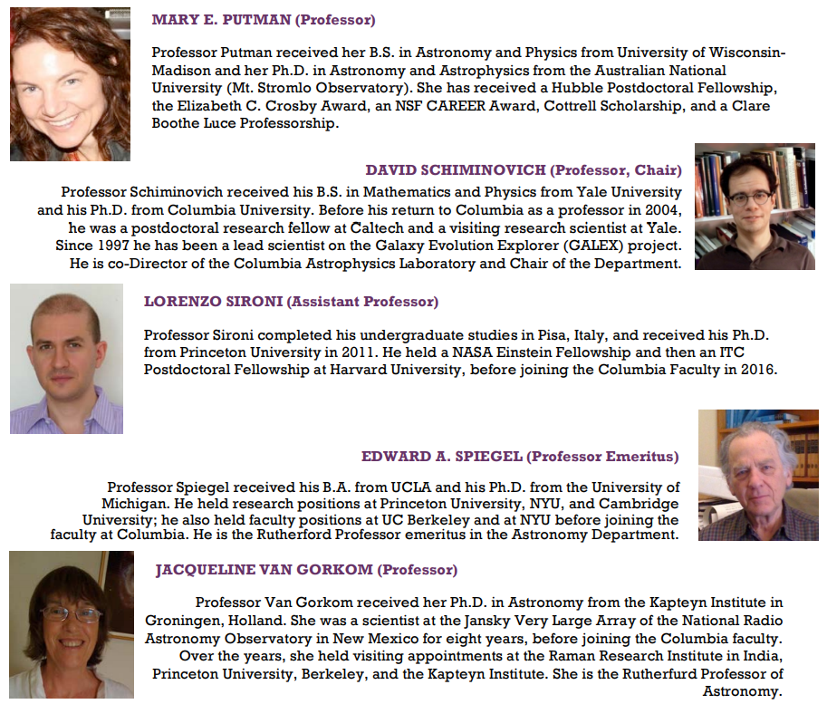

Slide 8

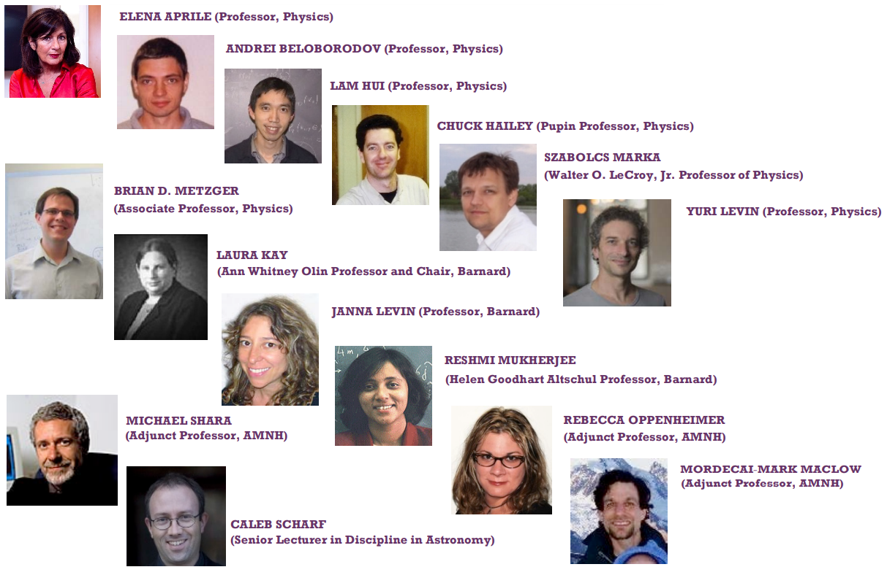
AFFILIATED FACULTY

Slide 9
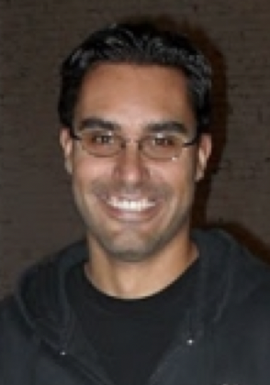
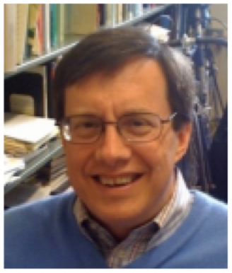
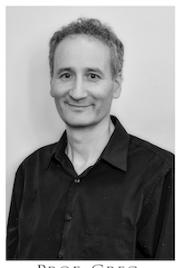
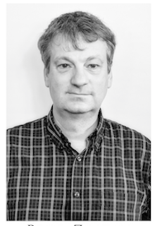
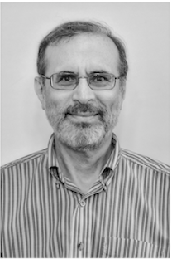
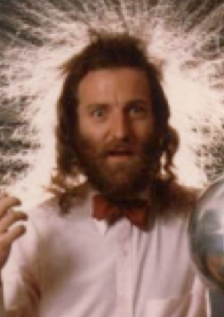
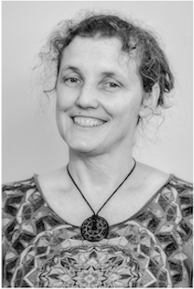
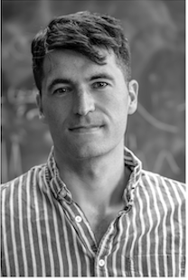
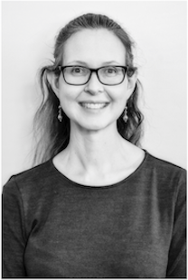
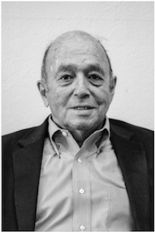
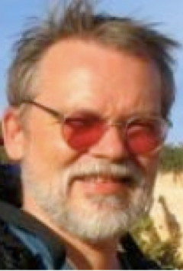
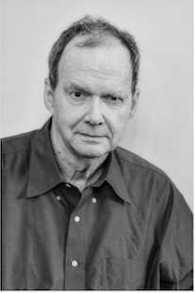
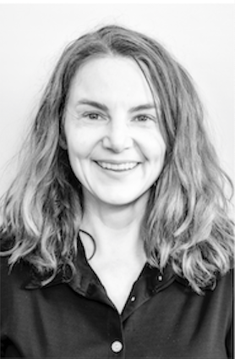
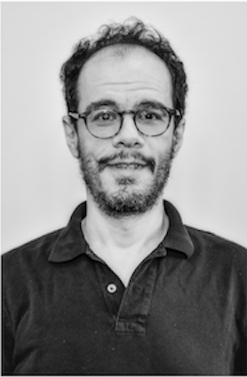
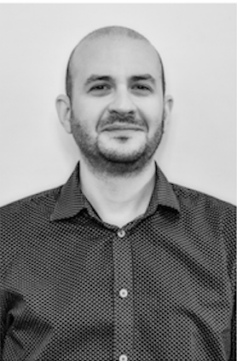
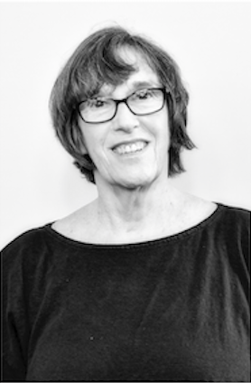
Faculty
Marcel
Agüeros
1327
Jim
Applegate
1322
Greg
Bryan
1325
Zoltan
Haiman
1326
Jules
Halpern
1014
David
Helfand
1020
Kathryn
Johnston
1320
David
Kipping
1331
Melissa
Ness
1325
Jerry
Ostriker
1024
Frits
Paerels
1022
Joe
Patterson
1422
Mary
Putman
1318
David
Shiminovich
1324
Lorenzo
Sironi
1012
Jacqueline
Van Gorkom
1420
Astronomy Department Office – Room 1328

Slide 10
Affiliated Faculty
Marcel
Agüeros
1327
Jim
Applegate
1322
Greg
Bryan
1325
Zoltan
Haiman
1326
Jules
Halpern
1014
David
Helfand
1020
Kathryn
Johnston
1320
David
Kipping
1331
Melissa
Ness
1325
Jerry
Ostriker
1024
Frits
Paerels
1022
Joe
Patterson
1422
Mary
Putman
1318
David
Shiminovich
1324
Lorenzo
Sironi
1012
Jacqueline
Van Gorkom
1420
Astronomy Department Office – Room 1328

Slide 11
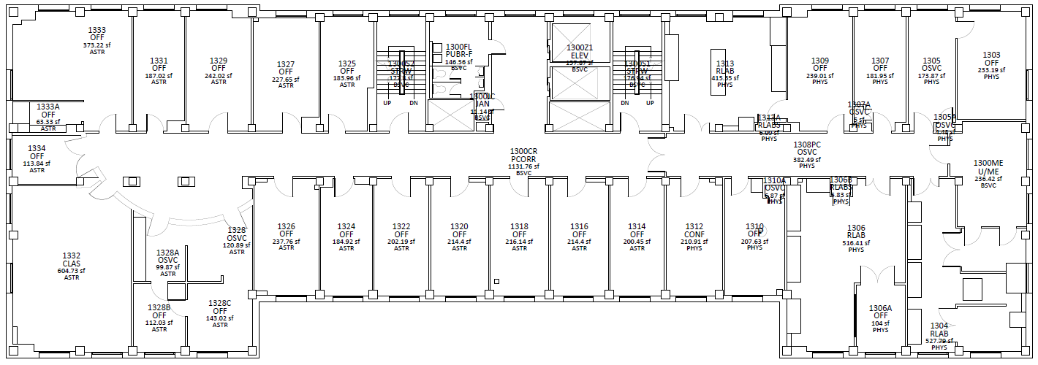
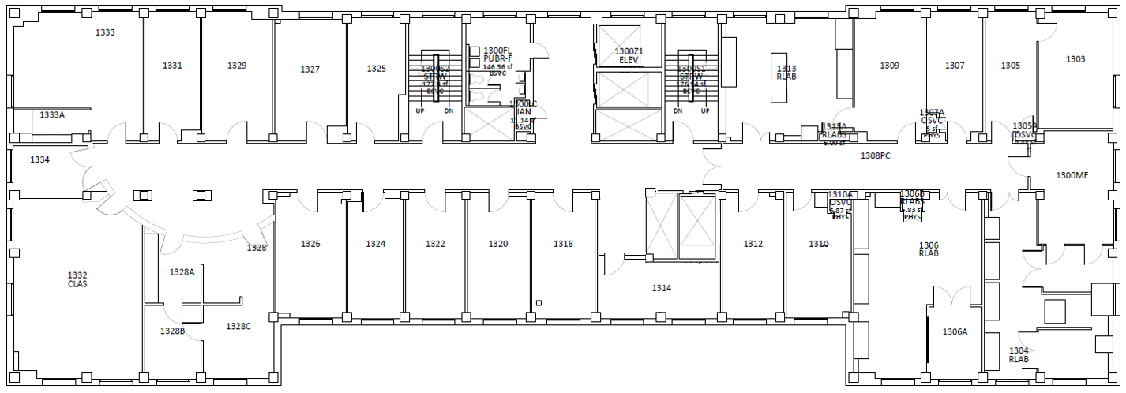
Mildred Garcia
Department Administrator
Zoltan Haiman
Professor of Astronomy
James Applegate
Professor of Astronomy
Mary Putman
Professor of Astronomy
Seminar Classroom
Ayoune Payne
Administrative Aide
David Schiminovich
Professor of Astronomy
Chair, Department of Astronomy
Co-Director Astrophysics Lab
Kathryn Johnston
Professor of Astronomy
Astronomy Department– 13th floor

Slide 12
Graduate Student
Office
David Kipping
Assistant Professor of Astronomy
Postdoctoral Office
Marcel Agüeros
Associate Professor of Astronomy
Greg Bryan
Professor of Astronomy
Melissa Ness
Assistant Professor of Astronomy
Astronomy Department– 13th floor

Slide 13
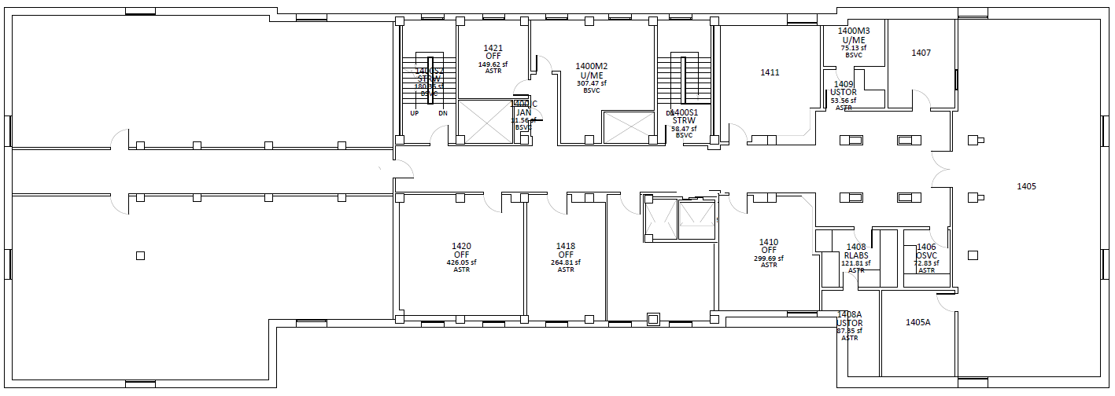
1422
1420
1414
Jennifer Sokoloski
Research Scientist
Jacqueline Van Gorkom
Rutherfurd Professor of Astronomy
Graduate Students
Offices
Visitor’s Room
Astronomy Library
Joseph Patterson
Professor of Astronomy
Postdoctoral Office
Jana Grcevich
Outreach Coordinator in the Columbia Astrophysics Laboratory
Kitchen
Additional Graduate Student Office Room 207
Astronomy Department– 14th floor

Slide 14
Upcoming Event - Colloquium Arlin P. S. Crotts Radical Hypothesis Lecture: Dark Stars Katherine Freese, UTexas February 12, 2020 4:05 pm Location: Pupin 1402 Host: Kathryn Johnston

Slide 15
Upcoming Event - Colloquium TBA - Levesque Emily Levesque, UWashington February 19, 2020 4:05 pm Location: TBD Host: Mike Hahn

Slide 16
Upcoming Event - Public Talk and Stargazing How Gravitational Waves Pointed Us to the Origin of Gold Brian Metzger February 14th, 2020 7pm 301 Pupin Hall

Slide 17
Upcoming Event - Public Talk and Stargazing Drifting Stars: Migration in the Milky Way Chris Carr February 21st, 2020 7pm 301 Pupin Hall

